Slide 1





EDUBOT – COLLEGE ENQUIRY CHATBOT
Created by:
Divyanshu Singh
Ashish Ranjan Singh

Slide 2


Problem Statement / Objective
.
Objective:
To build a college enquiry chatbot that provides quick responses to common student queries using Java and MySQL.
Problem Solved:
Students waste time asking repetitive questions about fees, exams, timetable, etc. EduBot helps automate this process.
SWIPE

Slide 3
Features of EduBot
✓ GUI-based chatbot using Java Swing
✓ Responds to queries like:
- What is the fee?
- Who is the HOD?
- When is the exam?
✓ Connects to MySQL using JDBC
✓ Stores chat history in database
✓ Handles "help" and "exit" commands
✓ Error handling using try-catch
✓ Input validation to avoid crashes
SWIPE

Slide 4
Technologies Used
• Java (JDK 17) – Core language
• Java Swing – GUI design
• JDBC – Database connectivity
• MySQL – Backend database
• IntelliJ IDEA – IDE used
• GitHub – Version control and submission
SWIPE

Slide 5
System Architecture / Flowchart
[User] → [Chatbot GUI] → [ChatbotDAO] → [MySQL DB]
↑
[DBConnection.java]
• Inputs go through GUI → DAO → DB
• Responses are shown in output area
• Chat history saved in DB
SWIPE

Slide 6
Database Schema
Database Name: chatbot_db
Table 1: queries
- id (INT, PRIMARY KEY)
- question (VARCHAR)
- answer (TEXT)
Table 2: chat_history
- id (INT, PRIMARY KEY)
- question (TEXT)
- answer (TEXT)
- timestamp (TIMESTAMP)
SWIPE

Slide 7
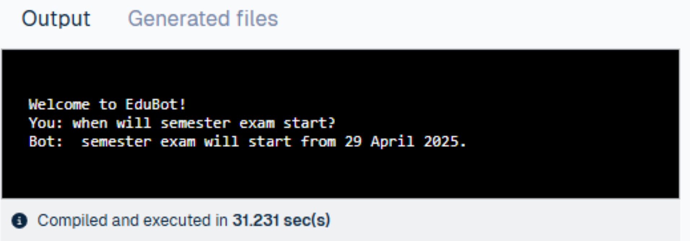

Slide 8
Conclusion & Future Scope
Conclusion:
EduBot is a lightweight and efficient chatbot for college-related queries. It improves student experience and saves staff time.
Future Scope:
✓ Add voice-based input
✓ Deploy as a web-based chatbot
✓ Add multilingual support
✓ Integrate with WhatsApp or Telegram
BACK

